Slide 1
MBTI Classification for online conversation
DSI_TDA_03
Kamlarp Satchavarodom
November 2023

Slide 2
outline
Problem statement
Context to the problem
Procedure
Answer to the problem

Slide 3
Problem statement
Target Audience
The primary target audience for this research is:
Online Platform Developers

Slide 4
Who are you? & How can I help you?
Problem statement

Slide 5
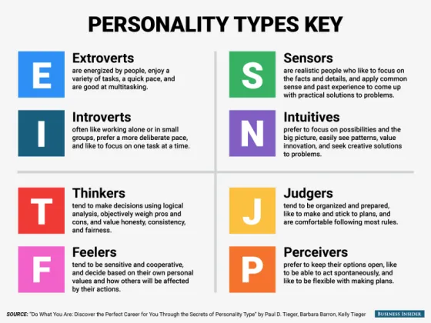
Context to Problem Statement
MBTI is personality type which can help us understand more about ourselves and other people, so we can help us and others more

Slide 6
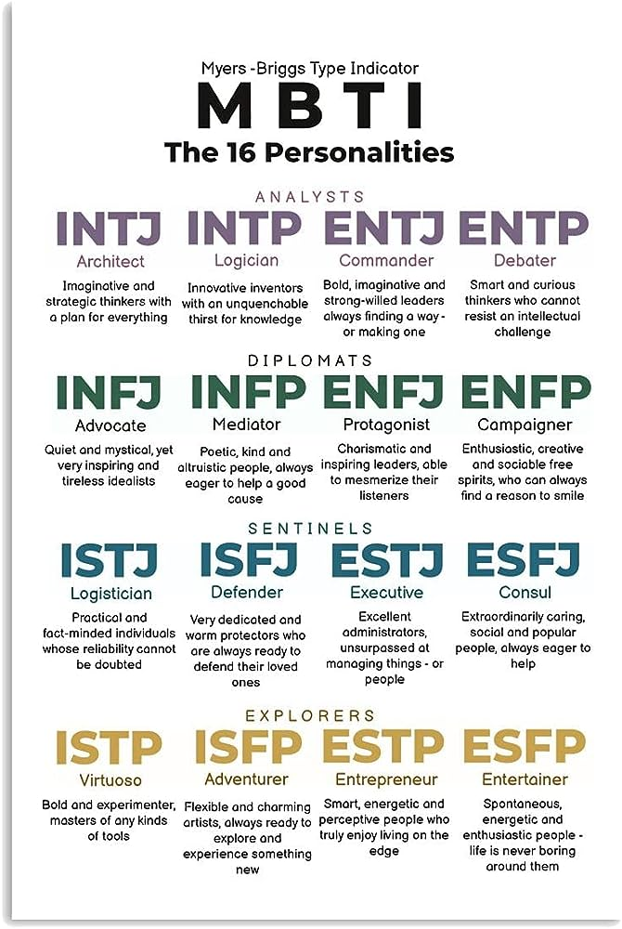
Context to Problem Statement
MBTI has 16 personality type

Slide 7
" Can we leverage our online conversational data to classify MBTI personality type and use it to enhance online engagement?"
Problem statement

Slide 8
Problem statement
Case Studies Reference
Case Study 1: Predicting Personality Types from Twitter Posts
https://www.researchgate.net/publication/366614754_Personality_Prediction_from_Twitter_Dataset_using_Machine_Learning
Case Study 2: Personality Type Based on Myers-Briggs Type Indicator with Text Posting Style by using Traditional and Deep Learning
https://arxiv.org/pdf/2201.08717.pdf

Slide 9
Problem statement
Research Methodology
Model Development Using Subreddit Posts:
We will develop a predictive model using posts from two subreddit forums, specifically the subreddits dedicated to the INFP and ESTJ Myers-Briggs personality types. This phase focuses on analyzing the language and content of these posts to classify them according to the personality type they most likely represent.

Slide 10
Procedure
We structure our method in 7 steps to achieve create this price prediction tool
2000 posts
Data preprocessing
Load INFP subreddit data
Load ESTJ subreddit data
Combine data
Exclude URL data
Base Model Building
Base Model 1
Include all
Base Model 2
Exclude Reddit Specific Data
Base Model 3
Exclude MBTI specific data
Model Tuning
Tuning 1
Vectorization,
Stemming/
Lemmatization
Tuning 2
Model Selection
Tuning 3
Parameter Tuning

Slide 11
Procedure
Let's focus on base model building
Data preprocessing
Load INFP subreddit data
Load ESTJ subreddit data
Combine data
Exclude URL data
Base Model Building
Base Model 1
Include all
Base Model 2
Exclude Reddit Specific Data
Base Model 3
Exclude MBTI specific data
Model Tuning
Tuning 1
Vectorization,
Stemming/
Lemmatization
Tuning 2
Model Selection
Tuning 3
Parameter Tuning

Slide 12
Answer to the problem
We use 5 columns
Base Model Building
Base Model 1
Include all
Base Model 2
Exclude Reddit Specific Data
Base Model 3
Exclude MBTI specific data
5 columns including 'link_flair_text','text','num_comments', 'selftext_length', 'title_length', 'title_emoji_count'
link_flair_text is categorical data which we get dummify
text is text data which we tokenize
other columns are numerical data which we do standard scaling

Slide 13
Answer to the problem
And we get very high score but overfitting
Base Model Building
Base Model 1
Include all
Base Model 2
Exclude Reddit Specific Data
Base Model 3
Exclude MBTI specific data
Accuracy Score
Train
1.0
Test
0.98
VS

Slide 14
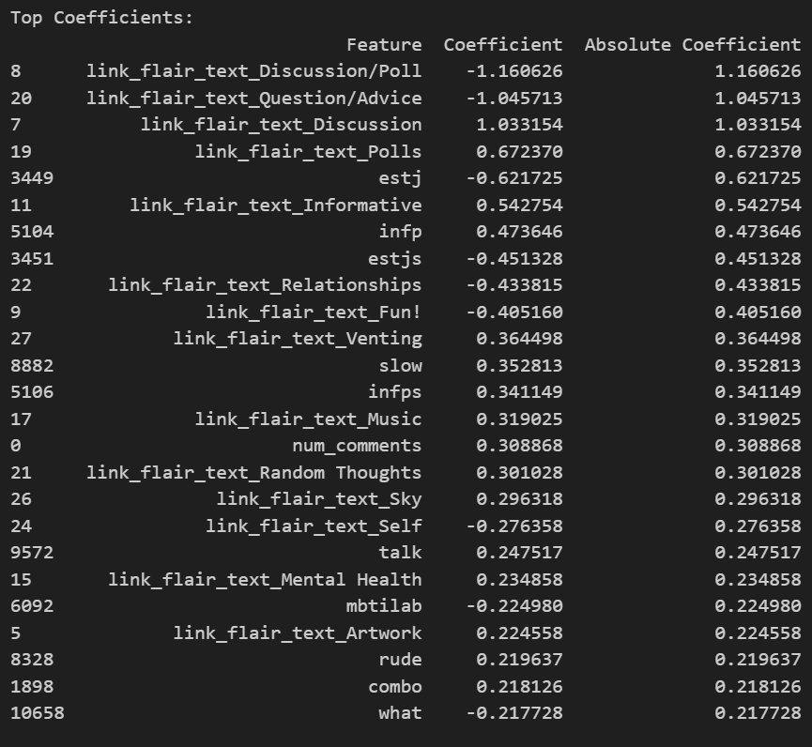
Answer to the problem
after in investigating coefficient, we found that link_flair_text column and word 'infp', 'estj', 'infps', 'estjs' are top coefficient
Base Model Building
Base Model 1
Include all
Base Model 2
Exclude Reddit Specific Data
Base Model 3
Exclude MBTI specific data

Slide 15
Answer to the problem
We eliminate the link_flair_text column (post type) which is specific to reddit website and get lower score
Base Model Building
Base Model 1
Include all
Base Model 2
Exclude Reddit Specific Data
Base Model 3
Exclude MBTI specific data
Accuracy Score
Train
1.0
Test
0.88
VS

Slide 16
Answer to the problem
We exclude word ‘infp’, ‘estj’, infps’, ‘estjs’ which is specific to MBTI and can be data leakage and get even lower score
Base Model Building
Base Model 1
Include all
Base Model 2
Exclude Reddit Specific Data
Base Model 3
Exclude MBTI specific data
Accuracy Score
Train
1.0
Test
0.81
VS

Slide 17
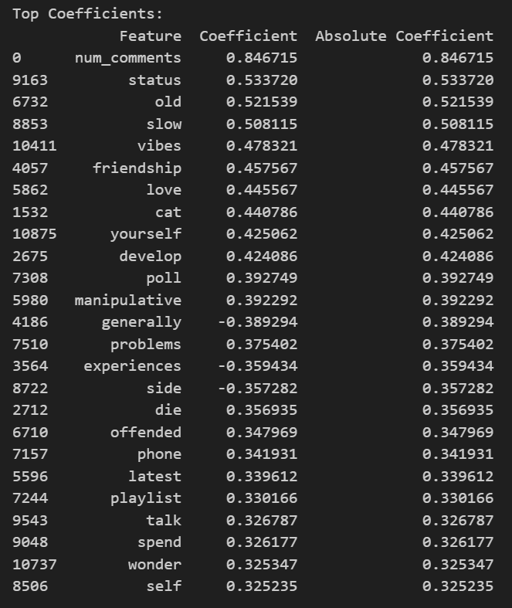
Answer to the problem
Num of comments appear as no.1 coefficients; INFP post seem to have more comments than ESTJ post
Base Model Building
Base Model 1
Include all
Base Model 2
Exclude Reddit Specific Data
Base Model 3
Exclude MBTI specific data

Slide 18
Procedure
Let’s move to model tuning to increase our score
Data preprocessing
Load INFP subreddit data
Load ESTJ subreddit data
Combine data
Exclude URL data
Base Model Building
Base Model 1
Include all
Base Model 2
Exclude Reddit Specific Data
Base Model 3
Exclude MBTI specific data
Model Tuning
Tuning 1
Vectorization,
Stemming/
Lemmatization
Tuning 2
Model Selection
Tuning 3
Parameter Tuning

Slide 19
Answer to the problem
We test vectorization and stemming / lemmatization
Model Tuning
Tuning 1
Vectorization,
Stemming/
Lemmatization
Tuning 2
Model Selection
Tuning 3
Parameter Tuning
Vectorization Method Stemming Lemmatization Accuracy
0 Count Vectorizer True True 0.88
1 Count Vectorizer False False 0.87
2 TF-IDF Vectorizer True True 0.83
3 TF-IDF Vectorizer False False 0.84
Up from base model at 0.81

Slide 20
Answer to the problem
We test 7 models and 2 models emerge as best performers
Model Tuning
Tuning 1
Vectorization,
Stemming/
Lemmatization
Tuning 2
Model Selection
Tuning 3
Parameter Tuning
for tunning 2, we have total 7 model for selection including Logistic Regression, KNN, Bagged Decision Tree, Random Forest, ADA Boost, G Boost, SVM
Model Accuracy 0 Logistic Regression 0.880488
1 KNN 0.697561
2 Bagged Decision Tree 0.843902
3 Random Forest 0.880488
4 AdaBoost 0.753659
5 Gradient Boost 0.814634
6 SVM 0.775610
Up from
base model at 0.81

Slide 21
Answer to the problem
We tune parameter further for logistic regression and random forest, and random forest performs the best
Model Tuning
Tuning 1
Vectorization,
Stemming/
Lemmatization
Tuning 2
Model Selection
Tuning 3
Parameter Tuning
Logistic regression
before tuning 0.89 vs after tuning 0.89
random forest
before tuning 0.89 vs after tuning 0.92
Up from base model at 0.81

Slide 22
Answer to the problem
Conclusion
- there is high potential for MBTI classification in online conversation, considering very high accuracy score of our best model (random forest) at 0.92 but it is still very overfit model because train compared to test score has the big gap 0.09
- we need to accumulate more post to get more text data to improve our score and reduce overfitting

Slide 23
Answer to the problem
Business Recommendation: we should move further to next step
1) Model Development Using Subreddit Posts:
We will develop a predictive model using posts from two subreddit forums, specifically the subreddits dedicated to the INFP and ESTJ Myers-Briggs personality types. This phase focuses on analyzing the language and content of these posts to classify them according to the personality type they most likely represent.
2) Expanding the Model to Include All 16 Personality Types:
The model will be expanded to cover all 16 Myers-Briggs personality types, involving posts from 16 different subreddits.
3) Shifting Focus from Posts to People:
The model will shift from classifying posts to classifying the people behind them. Participants will take the official MBTI test for model benchmarking.
4) Testing and Adapting the Model Across Platforms:
The model will be tested and adjusted across various online platforms, analyzing user behavior and interactions.
5) Testing with marketing campaign:
the model will be tested with marketing professional on each platform to select target group and personalize content for each personality type, using A/B testing to see the result changes in the marketing metrics

